Slide 1



Active Directory : SME L3
Exp: Min. 8 Years
SQL Migration : L2
Exp: Min. 5 Years
Windows 2016
Migratio: L2
Exp: 4 to 6 Years
Asset Management : L2
Exp: 4 to 6 Years
Interested associates are required to share their resumes with Nagpurmihan.RMG@tcs.com
VOIP Upgrade Voice Strategy:L2
Exp: 4 to 8 Yrs
Active Directory AD : L2
Exp: Min. 5+ Years
Project Management:L3/L4
Exp: Min. 7 Years
ADFS : L2
Exp: Min. 5 Years

Slide 2


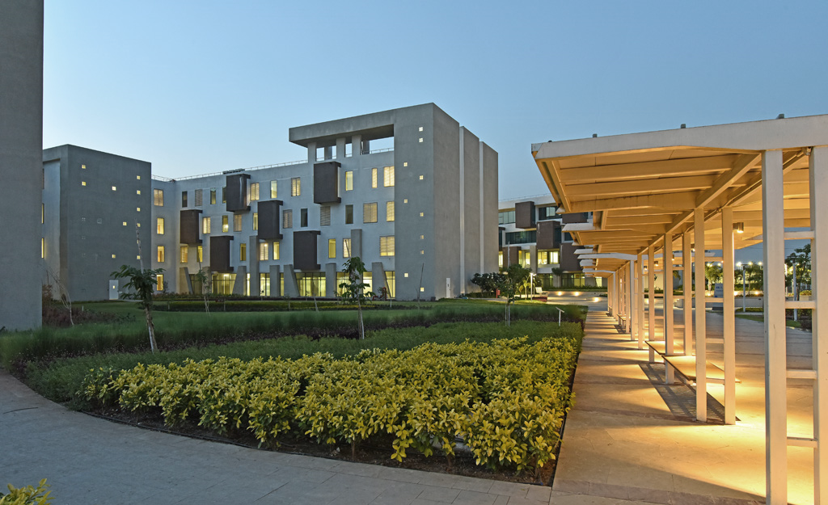
IT OPPORTUNITIES
AT
TCS - NAGPUR
Active Directory : SME L3
Exp: Min. 8 Years
VOIP Upgrade Voice Strategy:L2
Exp: 4 to 8 Yrs
SQL Migration : L2
Exp: Min. 5 Years
Active Directory AD : L2
Exp: Min. 5+ Years
INTERESTED ASSOCIATES ARE REQUIRED TO SHARE THEIR RESUMES WITH
NAGPURMIHAN.RMG@TCS.COM
Windows 2016 Upgradation /
Migration : L2
Exp: 4 to 6 Years
Project Management:L3/L4
Exp: Min. 7 Years
Asset Management : L2
Exp: 4 to 6 Years
ADFS : L2
Exp: Min. 5 Years

